Slide 1
Data Mining Know your Data

Slide 2
Getting to Know Your Data
Data Objects and Attribute Types
Basic Statistical Descriptions of Data
Data Visualization
Measuring Data Similarity and Dissimilarity
Summary

Slide 3
Data Objects
Data sets are made up of data objects.
A data object represents an entity.
Examples:
sales database: customers, store items, sales
medical database: patients, treatments
university database: students, professors, courses
Also called samples , examples, instances, data points, objects, tuples.
Data objects are described by attributes.
Database rows -> data objects; columns ->attributes.

Slide 4
Attributes
Attribute (or dimensions, features, variables): a data field, representing a characteristic or feature of a data object.
E.g., customer _ID, name, address
Types:
Nominal
Binary
Numeric: quantitative
Interval-scaled
Ratio-scaled

Slide 5
Attribute Types
Nominal: categories, states, or “names of things”
Hair_color = {black, blond, brown, grey, red, white}{0,1,2…}
marital status, occupation, ID numbers (numbers but math operations can’t be done on them), zip codes
No mean and median but mode can be used
Binary
Nominal attribute with only 2 states (0 and 1)
Symmetric binary: both outcomes equally important
e.g., gender
Asymmetric binary: outcomes not equally important.
e.g., medical test (positive vs. negative)
Convention: assign 1 to most important outcome (e.g., HIV positive)
Ordinal
Values have a meaningful order (ranking) but magnitude between successive values is not known.
Size = {small, medium, large}, grades, army rankings

Slide 6
Numeric Attribute Types
Quantitative (integer or real-valued). Can do math on them i.e. mean, median and mode, etc.
Interval Scaled
Measured on a scale of equal-sized units
Values have order
E.g., temperature in C˚or F˚, calendar dates
No true zero-point. 0˚ C is not showing “no temp”
Ratio Scaled
Inherent zero-point
e.g., length, counts, monetary quantities, years of experience, word counts, weight, height etc.

Slide 7
Discrete vs. Continuous Attributes
Discrete Attribute
Has only a finite or countably infinite set of values
E.g., zip codes, profession, or the set of words in a collection of documents
Attributes Hair_Color, Smoker, Med Test, Drink_Size each have a finite number of values, thus are discrete.
Discrete attributes may have numeric values 0 and 1 for binary attributes
Age have values from 0 to 110
Customer_ID is countably infinite
Zip codes

Slide 8
Discrete vs. Continuous Attributes
Continuous Attribute
Has real numbers as attribute values
E.g., temperature, height, or weight
Practically, real values can only be measured and represented using a finite number of digits
Continuous attributes are typically represented as floating-point variables

Slide 9
Chapter 2: Getting to Know Your Data
Data Objects and Attribute Types
Basic Statistical Descriptions of Data
Data Visualization
Measuring Data Similarity and Dissimilarity
Summary

Slide 10
Basic Statistical Descriptions of Data
Motivation
To better understand the data: central tendency, variation and spread
Data dispersion characteristics
median, max, min, quantiles, outliers, variance, etc.
Numerical dimensions correspond to sorted intervals
Data dispersion: analyzed with multiple granularities of precision
Boxplot or quantile analysis on sorted intervals
Notes:
Note to self (MK): last part of slide does not clearly match slides that follow
Introduction slides:
In the current version, we only talk about numeric data. Can we add some materials about non-numeric data.
- text statistics, TF/IDF
- visualization of text statistics such as word cloud
- distribution of Internet (IN, SCC, OUT, …)
- visualization of social relationship (e.g., http://renlifang.msra.cn/)

Slide 11
Measuring the Central Tendency
Mean (algebraic measure) (sample vs. population):
Note: n is sample size and N is population size.
Weighted arithmetic mean:
Trimmed mean: chopping extreme values
Median:
Middle value if odd number of values, or average of the middle two values otherwise
Mode
Value that occurs most frequently in the data
Unimodal, bimodal, trimodal
Empirical formula:
Mode for unimodal frequencies can be approximated if mean and median values are known

Slide 12
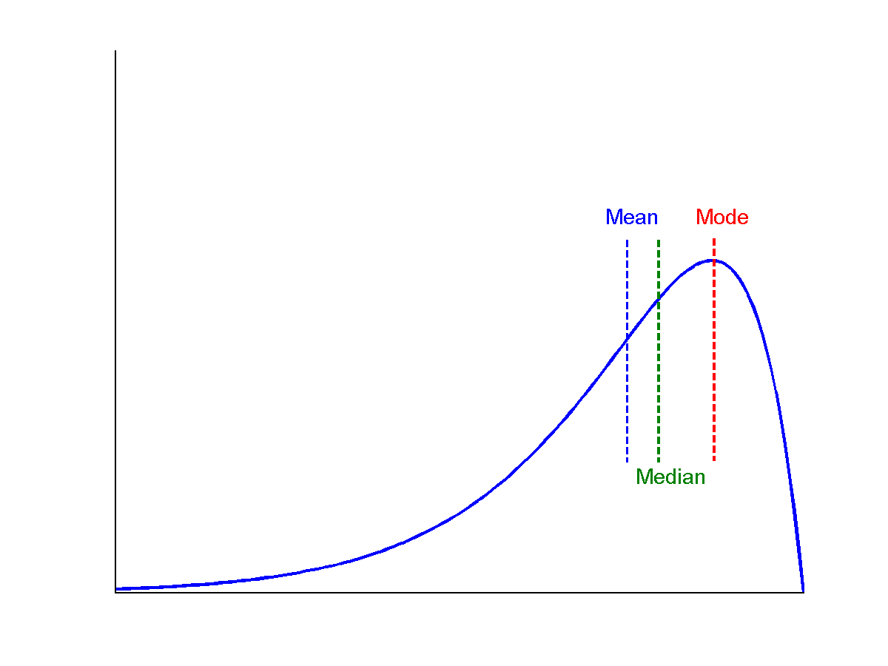
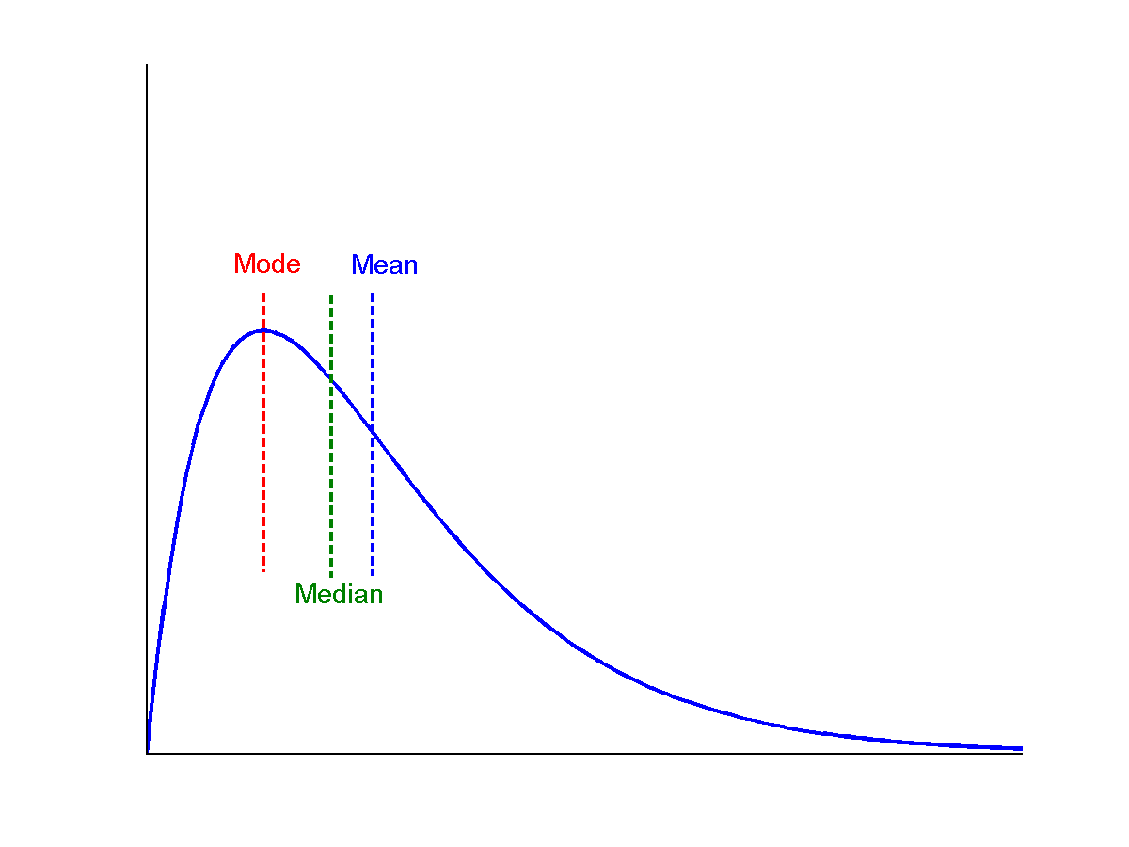
Symmetric vs. Skewed Data
Median, mean and mode of symmetric, positively and negatively skewed data
symmetric
positively skewed
negatively skewed

Slide 13
Measuring the Dispersion of Data
Quartiles, outliers and boxplots
Quartiles: Q₁ (25th percentile), Q₃ (75th percentile)
Inter-quartile range: IQR = Q₃ – Q₁
Five number summary: min, Q₁, median, Q₃, max
Boxplot: ends of the box are the quartiles; median is marked; add whiskers, and plot outliers individually
Outlier: usually, a value lower/higher
than o = (1.5 x IQR) of (Q1-o)/(Q3+o)

Slide 14
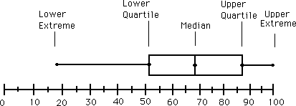
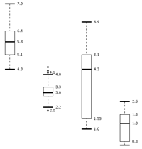
Boxplot Analysis
Five-number summary of a distribution
Minimum, Q1, Median, Q3, Maximum
Boxplot
Data is represented with a box
The ends of the box are at the first and third quartiles, i.e., the height of the box is IQR
The median is marked by a line within the box
Whiskers: two lines outside the box extended to Minimum and Maximum
Outliers: points beyond a specified outlier threshold, plotted individually
Notes:
Redraw the boxplot! Yes, we need a more real boxplot graph!

Slide 15
Exercise 1
Given the following data
7, 8, 7, 10, 7, 2, 8, 2, 7, 30
Median =
Q1 (index=2.5~3) =
Q3 (index=7.5~8) =
IQR = Q3 – Q1
5 number summary =
Outliers based on IQR =

Slide 16
Exercise 1 – Solution
Given the following data
7, 8, 7, 10, 7, 2, 8, 2, 7, 30
Sort the data 2,2,7,7,7,7,8,8,10,30
Median = 7
Q1 (index=10*.25=2.5~3) = 7
Q3 (index=10*.75=7.5~8) = 8
IQR = Q3 – Q1 = 8 – 7 = 1
Five number summary: min, Q₁, median, Q₃, max
5 number summary = 2, 7, 7, 8, 30
Outliers based on IQR =
IQR * 1.5 =1* 1.5=1.5 = x
Values which are less than (Q1 – x) Or greater than (Q3 + x)
Q1 – 1.5 = 7 – 1.5 = 5.5
Q3 + 1.5 = 8 + 1.5 = 9.5
Outliers = 2, 10, 30

Slide 17
Exercise 2
Find the outliers in the following using IQR
2,2,3,4,7,7,8,9,10,30
Find the outliers based on IQR
Q1 = 3
Q3 = 9
IQR = Q3 – Q1 = 9 – 3 = 6
x = 1.5 * IQR = 9
Outliers < Q1 – x = 3 – 9 = -6
Outliers > Q3 + x = 9 + 9 = 18
Outliers = 30

Slide 18
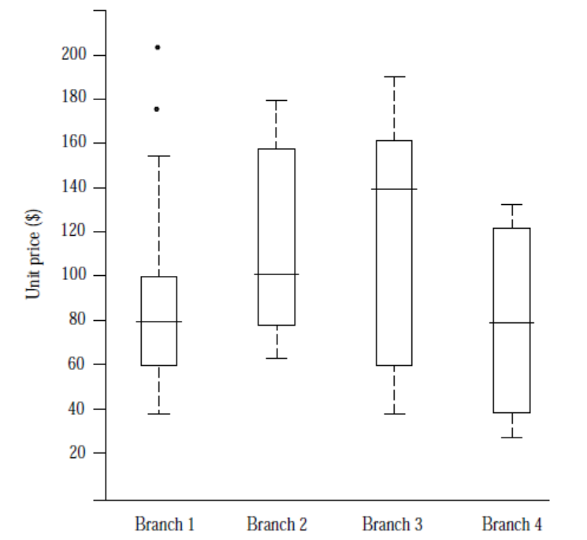
Boxplot Analysis

Slide 19
Lab Task 1
Import data sales_data.csv
See the metadata view to check the attribute type, statistics (mean, mode, etc.), range and no of missing values.
Create Boxplot for suitable fields

Slide 20
Python Hint
#Import Basic Libraries
import numpy as np # linear algebra
import pandas as pd # data processing, CSV file I/O (e.g. pd.read_csv)
import matplotlib.pyplot as plt #data visualization
import seaborn as sns #data visualization

Slide 21
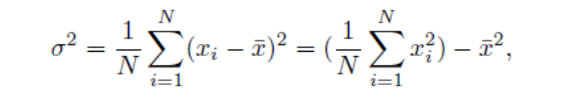
Variance and Standard Deviation
Variance and standard deviation
Variance: (algebraic, scalable computation)
Standard deviation s (or σ) is the square root of variance s² ⁽or σ²⁾
Variance and standard deviation are measures of data dispersion.
Low SD means observations are close to the mean
High SD means the data are spread out over a large range of values

Slide 22
Exercise 3: Find Variance and SD
5, 10, 15
N = 3
Mean = (5+10+15)/3 = 10
Var = ((5-10)^2 + (10-10)^2 + (15-10)^2) / N
= (-5^2 + 0^2 + 5^2) / 3
= (25 + 0 + 25) / 3 = 50/3 = 16.7
StDev = sqrt(Var) = sqrt(16.7) ~ 4

Slide 23
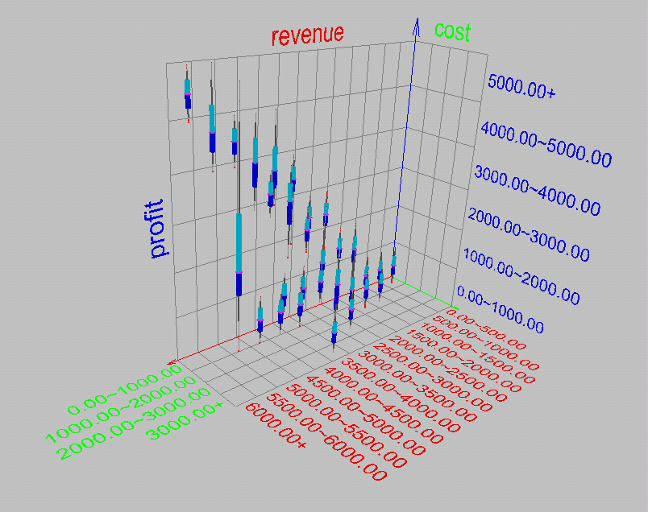
Visualization of Data Dispersion: 3-D Boxplots

Slide 24
Properties of Normal Distribution Curve
The normal (distribution) curve
From μ–σ to μ+σ: contains about 68% of the measurements (μ: mean, σ: standard deviation)
From μ–2σ to μ+2σ: contains about 95% of it
From μ–3σ to μ+3σ: contains about 99.7% of it

Slide 25
Lab Task2
Find normal distribution curve of usable attributes from your sales dataset

Slide 26
Graphic Displays of Basic Statistical Descriptions
Boxplot: graphic display of five-number summary
Histogram: x-axis are values, y-axis repres. frequencies
Scatter plot: each pair of values is a pair of coordinates and plotted as points in the plane
Notes:
JH: Maybe we can remove Loess curve

Slide 27
Histogram Analysis
Histogram: Graph display of tabulated frequencies, shown as bars
It shows what proportion of cases fall into each of several categories
Bar chart represents categorical data while histogram represents quantitative data
The categories are usually specified as non-overlapping intervals of some variable. The categories (bars) must be adjacent
Notes:
JH: A better and BASIC histogram figure --- because this one overlaps with a later one!

Slide 28
Exercise 4
Given the ages of the children:
9,7,12,10,5,4,8,2,4,3,1,2,8,14
Convert the data into ranges
Count the frequency for each range
Create a histogram

Slide 29
Exercise 4
Given the ages of the children:
9,7,12,10,5,4,8,2,4,3,1,2,8,14
Convert the data into ranges
1-5,6-10,11-15
Count the frequency for each range
1-5: 7, 6-10: 3, 11-15: 2
Create a barchart

Slide 30
Histograms Often Tell More than Boxplots
The two histograms shown in the left may have the same boxplot representation
The same values for: min, Q1, median, Q3, max
But they have rather different data distributions

Slide 31
Lab work
Create a histogram of amount
Create a histogram of single_price
Create a bar chart of product_category and single_price

Slide 32
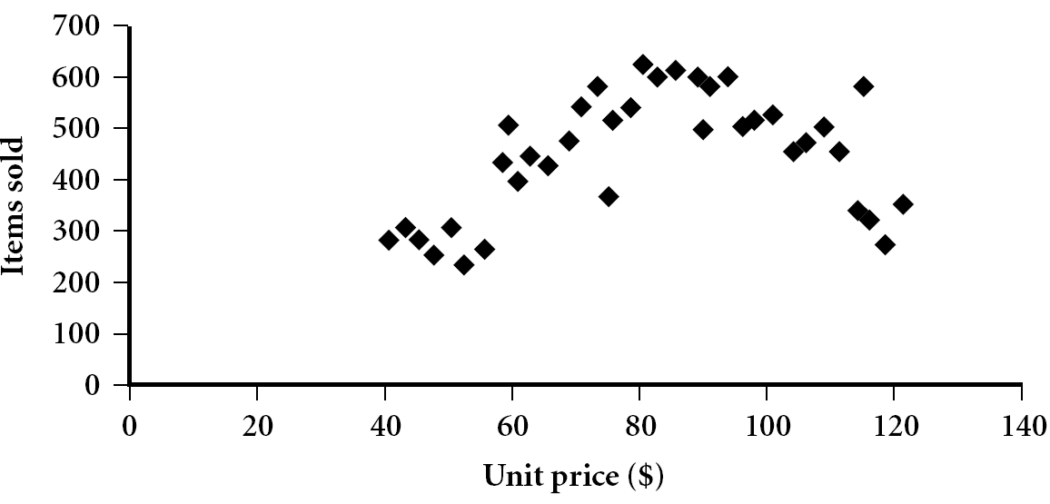
Scatter plot
Provides a first look at bivariate data (involving two attributes) to see clusters of points, outliers, etc
Each pair of values is treated as a pair of coordinates and plotted as points in the plane
Helps in finding if there is a correlation between two attributes
Notes:
Need a better and more MEANINGFUL scatter plot! -JH

Slide 33
Positively and Negatively Correlated Data
The left half fragment is positively correlated
The right half is negative correlated

Slide 34
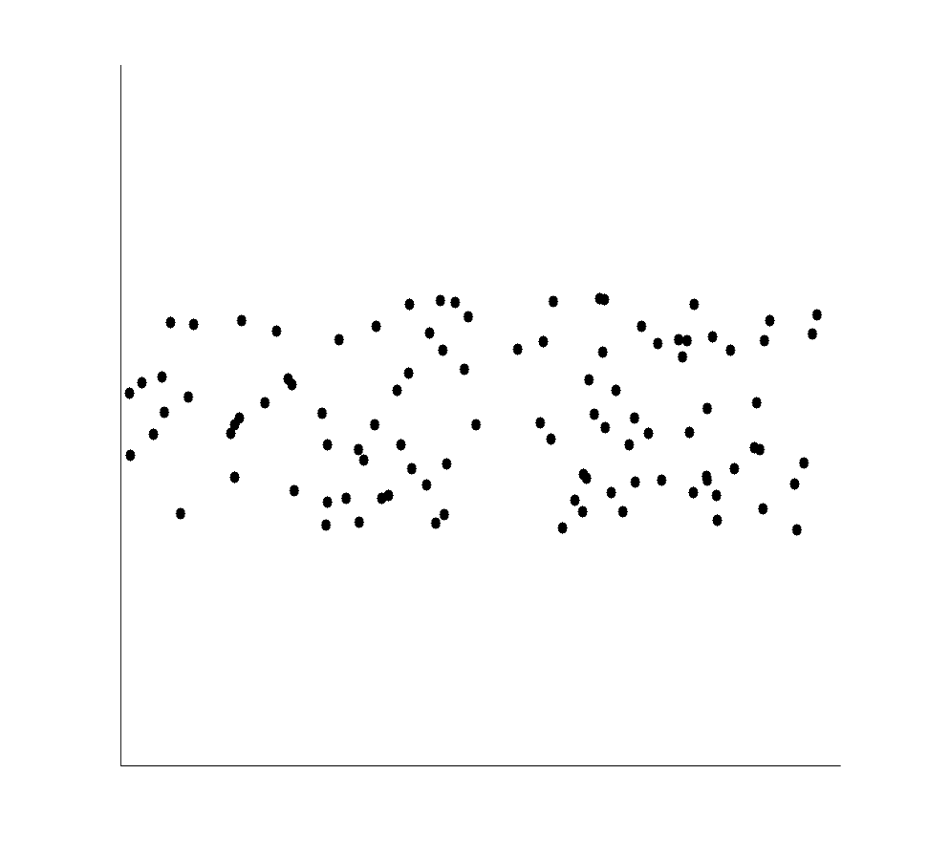
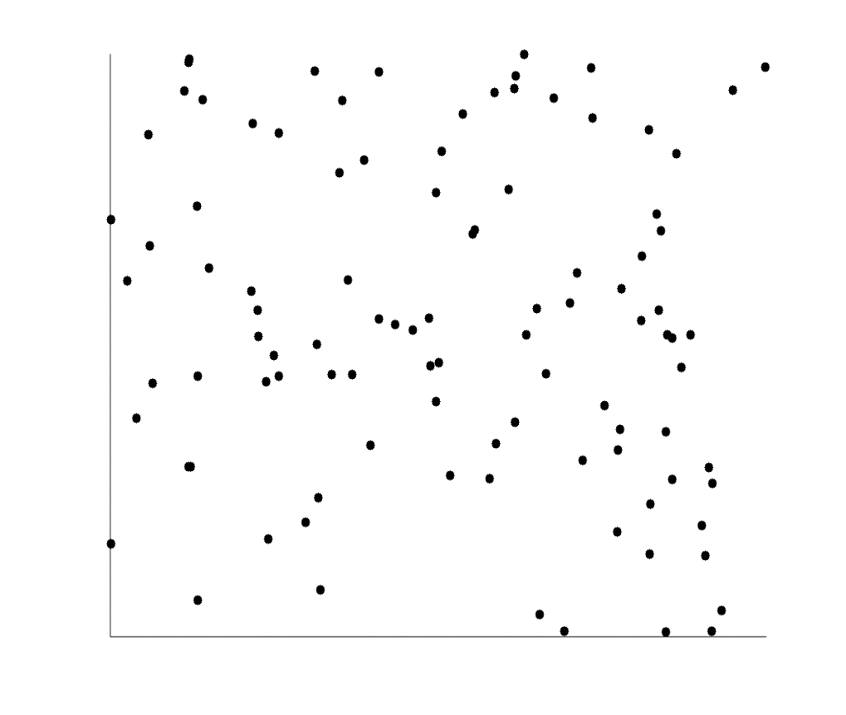
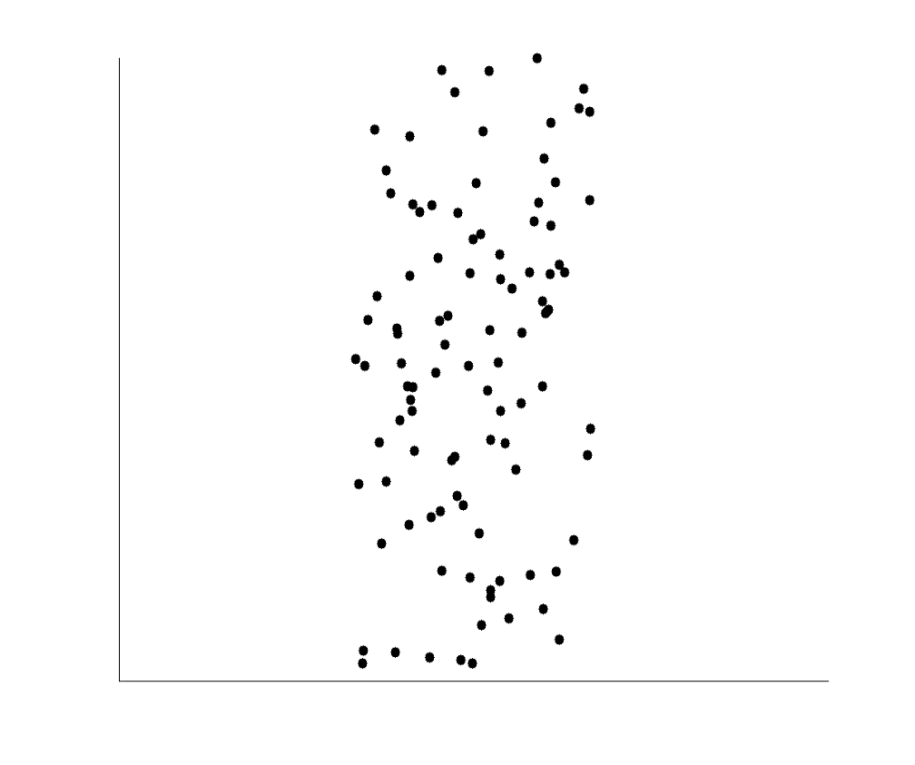
Uncorrelated Data

Slide 35
Exercise 6
Create a scatter plot for the following data
Age | Car Accidents
17 | 6
21 | 4
18 | 5
25 | 2
20 | 4
24 | 3

Slide 36
Exercise 6
Create a scatter plot for the following data
Age | Car Accidents
17 | 6
21 | 4
18 | 5
25 | 2
20 | 4
24 | 3

Slide 37
Chapter 2: Getting to Know Your Data
Data Objects and Attribute Types
Basic Statistical Descriptions of Data
Data Visualization
Measuring Data Similarity and Dissimilarity
Summary

Slide 38
Data Visualization
Why data visualization?
Gain insight into an information space by mapping data onto graphical primitives
Provide qualitative overview of large data sets
Search for patterns, trends, structure, irregularities, relationships among data
Help find interesting regions and suitable parameters for further quantitative analysis
Categorization of visualization methods:
Pixel-oriented visualization techniques
Icon-based visualization techniques
Hierarchical visualization techniques
Visualizing complex data and relations
Notes:
CC (conference call) 08.11.02: Need to check Wiki to update references.

Slide 39
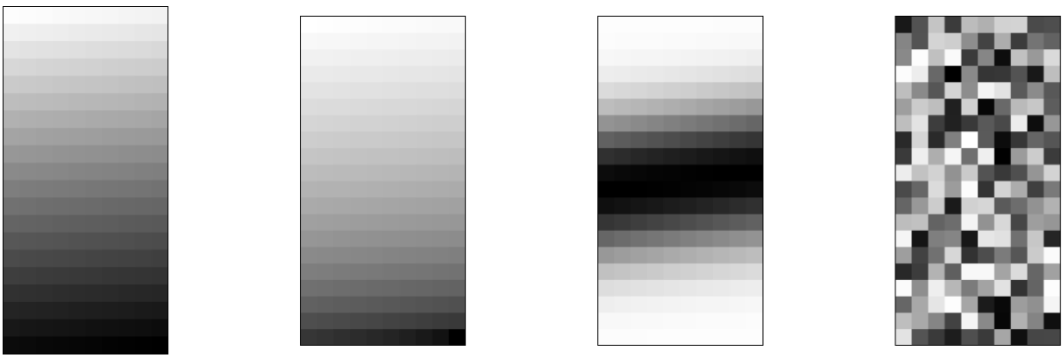
Pixel-Oriented Visualization Techniques
For a data set of m dimensions, create m windows on the screen, one for each dimension
The m dimension values of a record are mapped to m pixels at the corresponding positions in the windows
The colors of the pixels reflect the corresponding values
Income
(b) Credit Limit
(c) transaction volume
(d) age
39
Notes:
39
We can sort all customers in income-ascending order, and use this order to lay out the customer data in the four visualization windows, as shown in Figure 2.10. The pixel colors are chosen so that the smaller the value, the lighter the shading. Using pixel- based visualization, we can easily observe the following: credit limit increases as income increases; customers whose income is in the middle range are more likely to purchase more from AllElectronics; there is no clear correlation between income and age.

Slide 40
Icon-Based Visualization Techniques
Visualization of the data values as features of icons
Typical visualization methods
Chernoff Faces
Stick Figures
General techniques
Shape coding: Use shape to represent certain information encoding

Slide 41
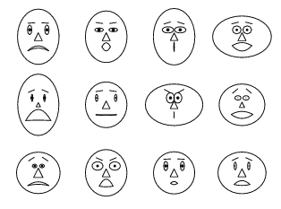
Chernoff Faces
A way to display variables on a two-dimensional surface, e.g., let x be eyebrow slant, y be eye size, z be nose length, etc.
The figure shows faces produced using 10 characteristics--head eccentricity, eye size, eye spacing, eye eccentricity, pupil size, eyebrow slant, nose size, mouth shape, mouth size, and mouth opening): Each assigned one of 10 possible values, generated using Mathematica (S. Dickson)
REFERENCE: Gonick, L. and Smith, W. The Cartoon Guide to Statistics. New York: Harper Perennial, p. 212, 1993
Weisstein, Eric W. "Chernoff Face." From MathWorld--A Wolfram Web Resource. mathworld.wolfram.com/ChernoffFace.html
Notes:
Dimensions can be mapped to the following facial characteristics: eye size, eye spacing, nose length, nose width, mouth curvature, mouth width, mouth openness, pupil size, eyebrow slant, eye eccentricity, and head eccentricity.

Slide 42
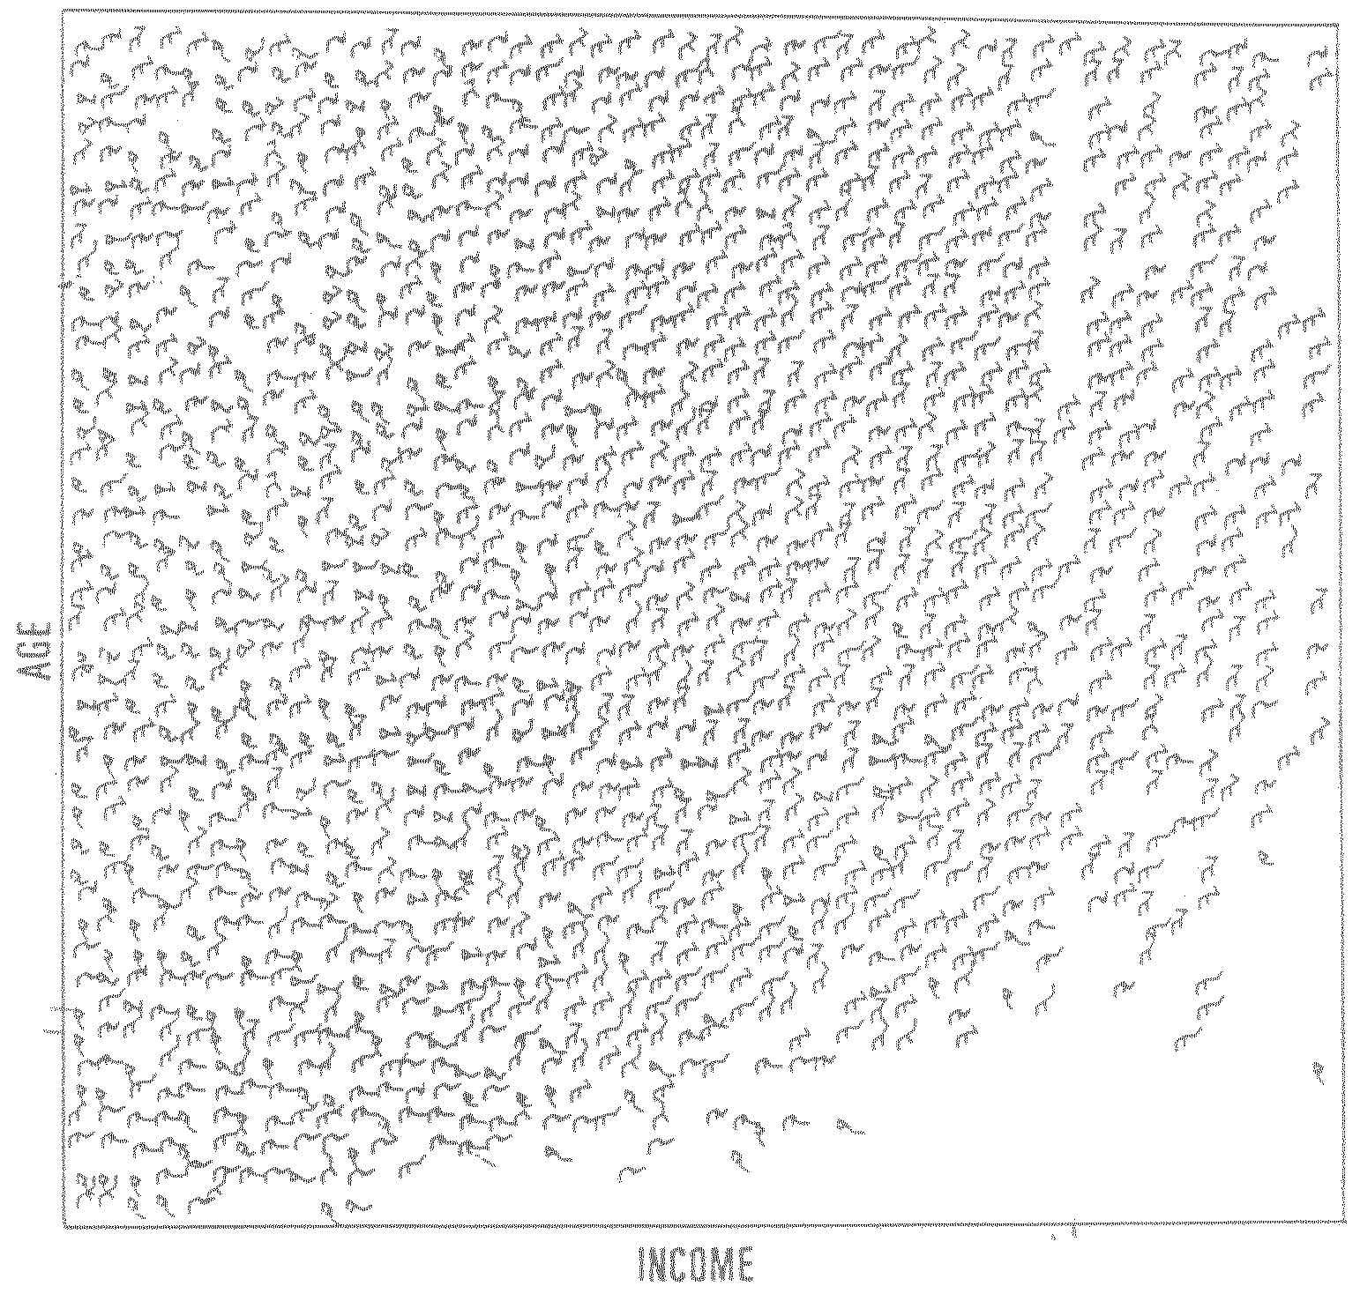
Stick Figure
A census data figure showing age, income, gender, education, etc.
used by permission of G. Grinstein, University of Massachusettes at Lowell
A 5-piece stick figure (1 body and 4 limbs w. different angle/length)
Notes:
“two attributes mapped to axes, remaining attributes mapped to angle or length of limbs”. Look at texture pattern.

Slide 43
Hierarchical Visualization Techniques
Visualization of the data using a hierarchical partitioning into subspaces
Methods
Tree-Map
Notes:
MK 08/10/18: Is it “Treemap” or “Tree-Map”? - inconsistent in this file.

Slide 44
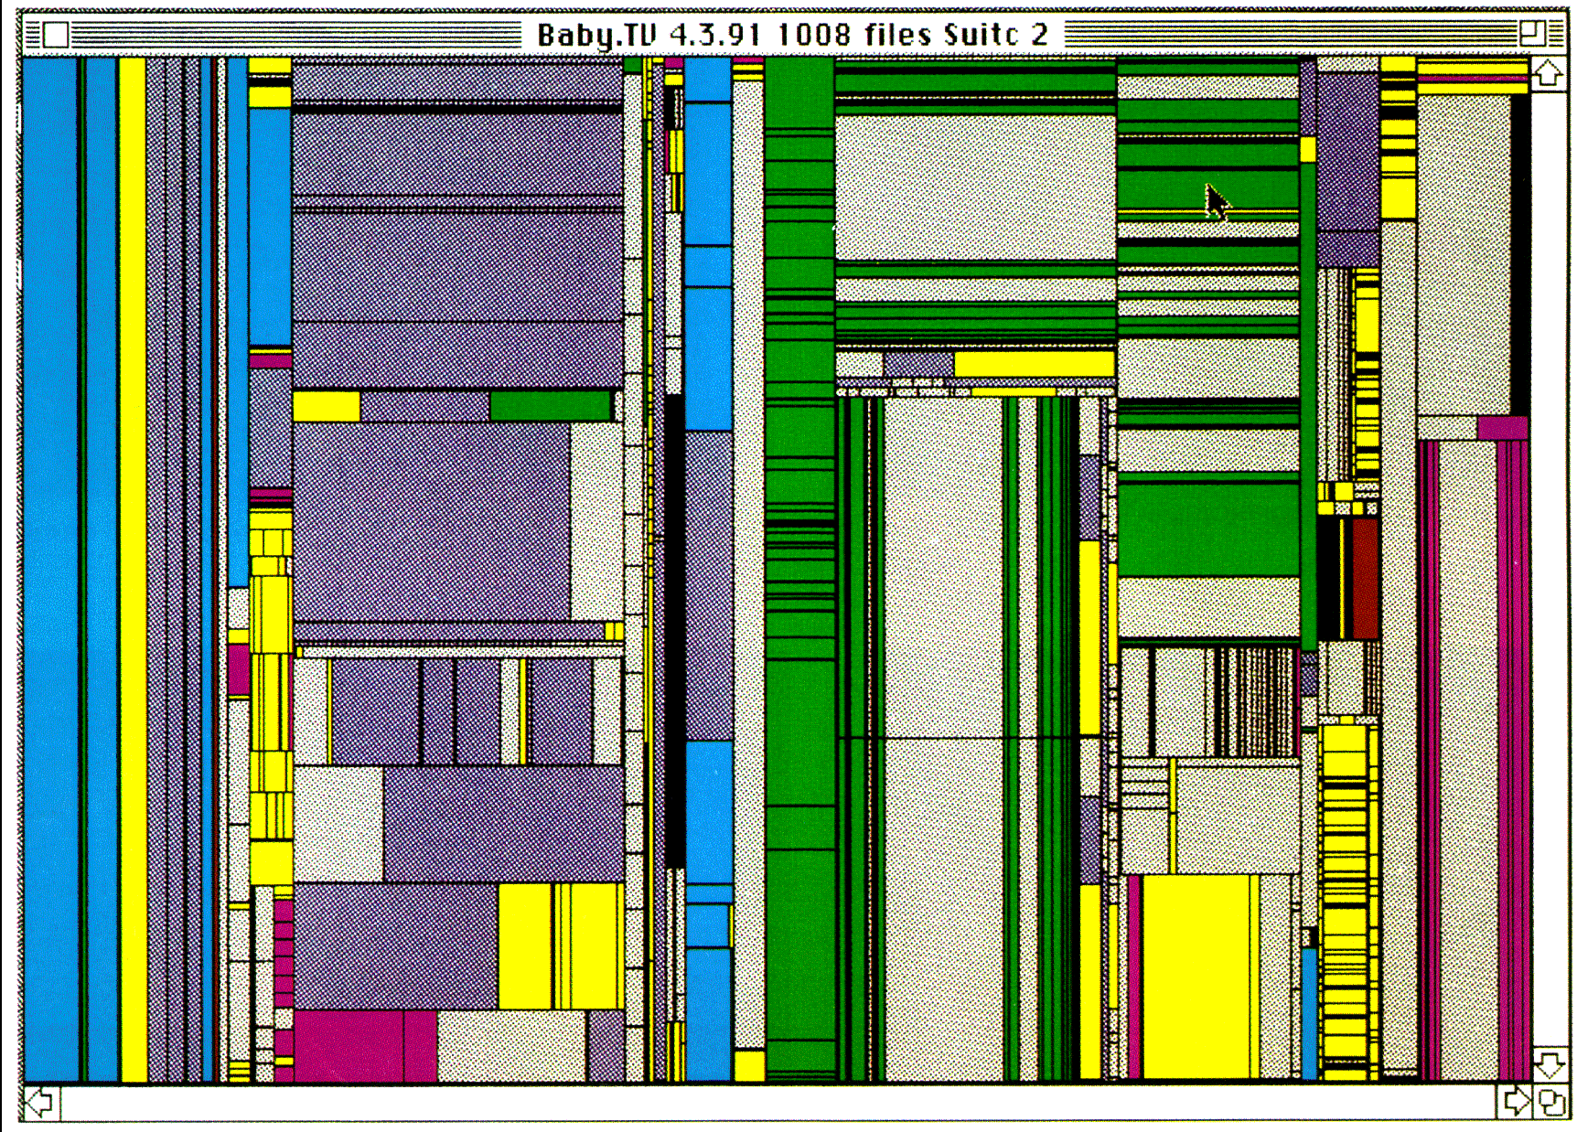
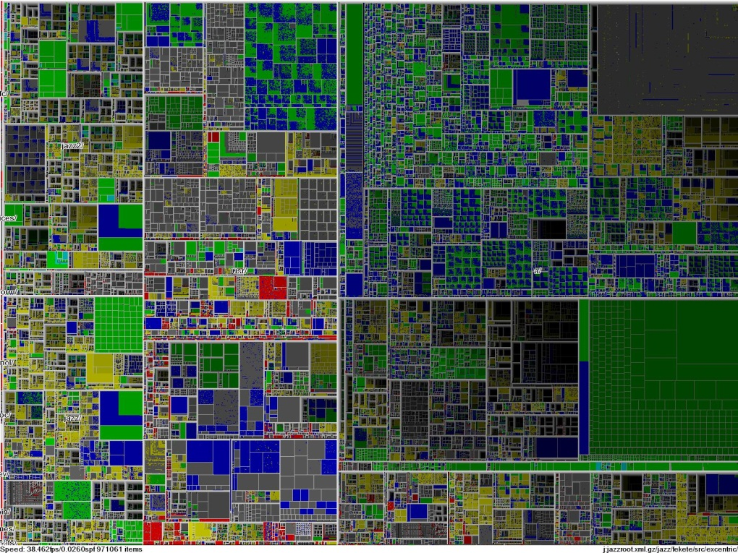
Tree-Map
Screen-filling method which uses a hierarchical partitioning of the screen into regions depending on the attribute values
Schneiderman@UMD: Tree-Map of a File System
Schneiderman@UMD: Tree-Map to support large data sets of a million items
Notes:
Picture: http://www.cs.umd.edu/hcil/treemap-history/

Slide 45

Visualizing Complex Data and Relations
Visualizing non-numerical data: text and social networks
Tag cloud: visualizing user-generated tags
The importance of tag is represented by font size/color
Besides text data, there are also methods to visualize relationships, such as visualizing social networks
Newsmap: Google News Stories in 2005
World Population Tag Cloud

Slide 46
Assignment 1
Find appropriate datasets from kaggle for the following visualization techniques and apply them
Pixel-oriented visualization
Chernoff faces
Stick figures
Tree map

Slide 47
Chapter 2: Getting to Know Your Data
Data Objects and Attribute Types
Basic Statistical Descriptions of Data
Data Visualization
Measuring Data Similarity and Dissimilarity
Summary

Slide 48
Similarity and Dissimilarity
Similarity
Numerical measure of how alike two data objects are
Value is higher when objects are more alike
Often falls in the range [0,1]
Dissimilarity (e.g., distance)
Numerical measure of how different two data objects are
Lower when objects are more alike
Minimum dissimilarity is often 0
Proximity refers to a similarity or dissimilarity
Notes:
Keep here because keeping it in clustering chapter seems far away. 08.11.02

Slide 49
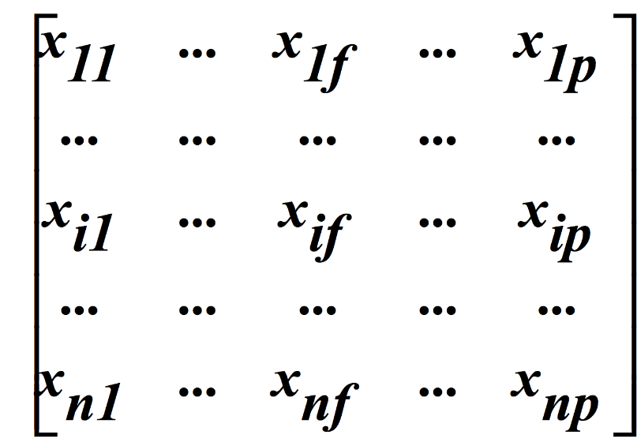
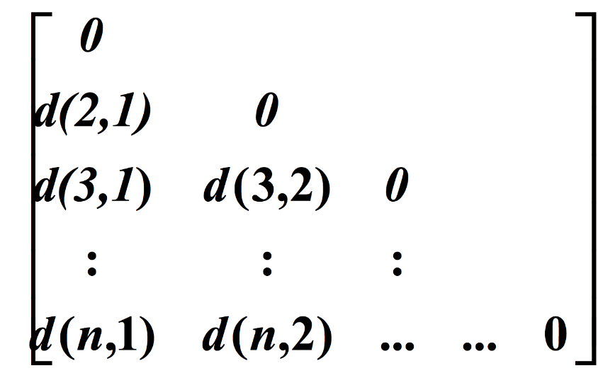
Data Matrix and Dissimilarity Matrix
Data matrix
n data points with p dimensions
Two modes
Dissimilarity matrix
n data points, but registers only the distance
A triangular matrix
Single mode
Notes:
Distance is just once way of measuring dissimilarity (wiki). Changed “register only the distance” to “registers only the difference” or “dissimiarity”?

Slide 50
Dissimilarity Measure for Nominal Attributes
Can take 2 or more states, e.g., red, yellow, blue, green (generalization of a binary attribute)
Method 1: Simple matching
m: # of matches, p: total # of variables
Method 2: Use a large number of binary attributes
creating a new binary attribute for each of the M nominal states. E.g. to encode nominal attr ‘color’, a binary attr can be created for each of the colors listed. Yellow will have 1, others 0

Slide 51
Exercise 7
Find the distance based on the attributes “Favorite Color” and “Favorite Food” between
Ali and Bilal
Ali and Faris
 | Favorite Color | Favorite Food | Plays Chess | Plays Football | Age | Salary (1000s) | Grade
Ali | Blue | Cake | Yes | Yes | 20 | 34 | C
Bilal | Yellow | Cake | Yes | Yes | 25 | 25 | B
Ehsan | Yellow | Pasta | Yes | No | 20 | 25 | C
Faris | Yellow | Burger | No | No | 20 | 25 | A

Slide 52
Exercise 7
Find the distance based on the attributes “Favorite Color” and “Favorite Food” between
Ali and Bilal
(2-1)/2= 0.5
Ali and Faris
(2-0)/2 = 1
 | Favorite Color | Favorite Food | Plays Chess | Plays Football | Age | Salary (1000s) | Grade
Ali | Blue | Cake | Yes | Yes | 20 | 34 | C
Bilal | Yellow | Cake | Yes | Yes | 25 | 25 | B
Ehsan | Yellow | Pasta | Yes | No | 20 | 25 | C
Faris | Yellow | Burger | No | No | 20 | 25 | A

Slide 53
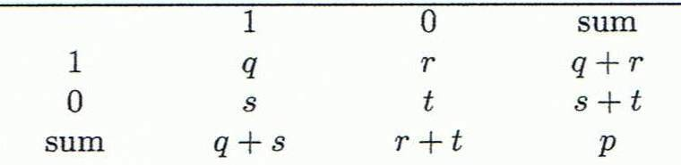
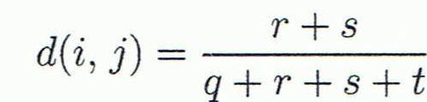
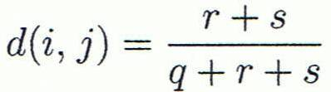
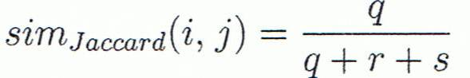
Proximity Measure for Binary Attributes
Object j
A contingency table for binary data
Dissimilarity measure for symmetric binary variables:
Dissimilarity measure for asymmetric binary variables:
Jaccard coefficient (similarity measure for asymmetric binary variables):
Object i
Notes:
MK: I tried to change equations so as to match notation in book, but each time I try to install the equation editor, it fails! Agh!

Slide 54
Dissimilarity between Binary Variables
Example
d(jack,mary), d(jack,jim)
d(jim,mary)
Let the values Y and P be 1, and the value N 0

Slide 55
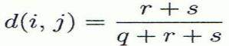
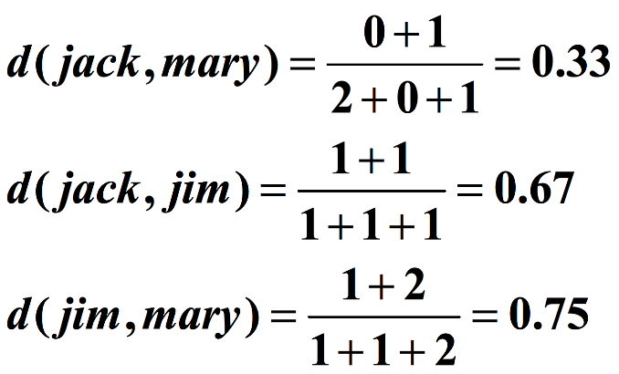
Dissimilarity between Binary Variables
Example
Let the values Y and P be 1, and the value N 0
Mary
 | 1 | 0 | ∑_{row}
1 | 2 | 0 | 2
0 | 1 | 3 | 4
∑_{col} | 3 | 3 | 6
Jack
Jim
 | 1 | 0 | ∑_{row}
1 | 1 | 1 | 2
0 | 1 | 3 | 4
∑_{col} | 2 | 4 | 6
Jack
Mary
 | 1 | 0 | ∑_{row}
1 | 1 | 1 | 2
0 | 2 | 2 | 4
∑_{col} | 3 | 3 | 6
Jim

Slide 56
Exercise 8
Find the distance based on the “symmetric” attributes “Plays Chess” and “Plays Football” between
Ali and Bilal
Ali and Faris
 | Favorite Color | Favorite Food | Plays Chess | Plays Football | Age | Salary (1000s) | Grade
Ali | Blue | Cake | Yes | Yes | 20 | 34 | C
Bilal | Yellow | Cake | Yes | Yes | 25 | 25 | B
Ehsan | Yellow | Pasta | Yes | No | 20 | 25 | C
Faris | Yellow | Burger | No | No | 20 | 25 | A

Slide 57
Exercise 8
Find the distance based on the “symmetric” attributes “Plays Chess” and “Plays Football” between
Ali and Bilal
dist(Ali,Bilal) = 0/2 = 0
Ali and Faris
dist(Ali,Faris) = 2/2 = 1
 | Favorite Color | Favorite Food | Plays Chess | Plays Football | Age | Salary (1000s) | Grade
Ali | Blue | Cake | Yes | Yes | 20 | 34 | C
Bilal | Yellow | Cake | Yes | Yes | 25 | 25 | B
Ehsan | Yellow | Pasta | Yes | No | 20 | 25 | C
Faris | Yellow | Burger | No | No | 20 | 25 | A

Slide 58
Distance on Numeric Data: Minkowski Distance
Minkowski distance: A popular distance measure
where i = (x_{i1}, x_{i2}, …, x_{ip}) and j = (x_{j1}, x_{j2}, …, x_{jp}) are two p-dimensional data objects, and h is the order (the distance so is also called L-h norm)

Slide 59
Special Cases of Minkowski Distance
h = 1: Manhattan (L₁ norm) distance
h = 2: (L₂ norm) Euclidean distance
h -> ∞ “supremum” (L_{max} norm, L ∞ norm) distance.
This is the maximum difference between any component (attribute) of the vectors

Slide 60
Example: Minkowski Distance
Dissimilarity Matrices
Manhattan (L₁)
Euclidean (L₂)
Supremum

Slide 61
Exercise 9
Find the distance based on the attributes “Age” and “Salary” between
Ali and Bilal (Euclidean)
Ali and Bilal (Supremum)
 | Favorite Color | Favorite Food | Plays Chess | Plays Football | Age | Salary (1000s) | Grade
Ali | Blue | Cake | Yes | Yes | 20 | 34 | C
Bilal | Yellow | Cake | Yes | Yes | 25 | 25 | B
Ehsan | Yellow | Pasta | Yes | No | 20 | 25 | C
Faris | Yellow | Burger | No | No | 20 | 25 | A

Slide 62
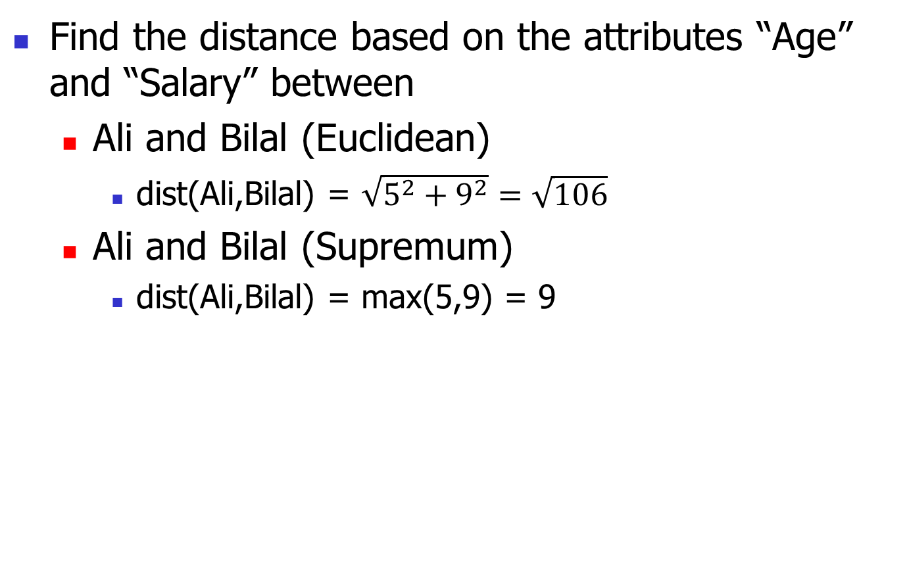
Exercise 9
Find the distance based on the attributes “Age” and “Salary” between
Ali and Bilal (Euclidean)
dist(Ali,Bilal) = $\sqrt{5^{2}+9^{2}}=\sqrt{106}$
Ali and Bilal (Supremum)
dist(Ali,Bilal) = max(5,9) = 9
 | Favorite Color | Favorite Food | Plays Chess | Plays Football | Age | Salary (1000s) | Grade
Ali | Blue | Cake | Yes | Yes | 20 | 34 | C
Bilal | Yellow | Cake | Yes | Yes | 25 | 25 | B
Ehsan | Yellow | Pasta | Yes | No | 20 | 25 | C
Faris | Yellow | Burger | No | No | 20 | 25 | A

Slide 63
Ordinal Variables
An ordinal variable can be discrete or continuous
Order is important, e.g., rank
Can be treated like interval-scaled
replace x_{if} by their rank
map the range of each variable onto [0, 1] by replacing i-th object in the f-th attribute by
compute the dissimilarity using methods for interval-scaled variables.

Slide 64
Exercise 10
Find the distance based on the attributes “Age”, “Salary”, and “Grade” between
Ali and Bilal (Euclidean)
Ali and Bilal (Supremum)
Set A=1, B=2, C=3
 | Favorite Color | Favorite Food | Plays Chess | Plays Football | Age | Salary (1000s) | Grade
Ali | Blue | Cake | Yes | Yes | 20 | 34 | C
Bilal | Yellow | Cake | Yes | Yes | 25 | 25 | B
Ehsan | Yellow | Pasta | Yes | No | 20 | 25 | C
Faris | Yellow | Burger | No | No | 20 | 25 | A

Slide 65
Exercise 10
Find the distance based on the attributes “Age”, “Salary”, and “Grade” between
Ali and Bilal (Manhattan)
dist(Ali,Bilal) = |20-25|+|34-25|+|1-0.5|=14.5
Ali and Bilal (Supremum)
dist(Ali,Bilal) = max(|20-25|,|34-25|,|1-0.5|)=9
 | Favorite Color | Favorite Food | Plays Chess | Plays Football | Age | Salary (1000s) | Grade | Grade (N)
Ali | Blue | Cake | Yes | Yes | 20 | 34 | C | 1
Bilal | Yellow | Cake | Yes | Yes | 25 | 25 | B | 0.5
Ehsan | Yellow | Pasta | Yes | No | 20 | 25 | C | 1
Faris | Yellow | Burger | No | No | 20 | 25 | A | 0

Slide 66
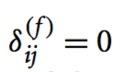
Attributes of Mixed Type
A database may contain all attribute types
Nominal, symmetric binary, asymmetric binary, numeric, ordinal
One may use a weighted formula to combine their effects
f is binary or nominal:
d_{ij}^{(f)} = 0 if x_{if} = x_{jf} , or d_{ij}^{(f)} = 1 otherwise
f is numeric: use the normalized distance
f is ordinal
Compute ranks r_{if} and
Treat z_{if} as interval-scaled
if x_{if} or x_{jf} is misssing
or x_{if} = x_{jf} = 0 for binary asymmetric attributes

Slide 67
Exercise 11
Find the distance based on all the attributes (mixed type)
Ali and Bilal
Ali and Faris
 | Favorite Color | Favorite Food | Plays Chess | Plays Football | Age | Salary (1000s) | Grade
Ali | Blue | Cake | Yes | Yes | 20 | 34 | C
Bilal | Yellow | Cake | Yes |  | 25 | 25 | B
Ehsan | Yellow | Pasta | Yes | No | 20 | 25 | C
Faris | Yellow | Burger | No | No | 20 | 25 | A

Slide 68
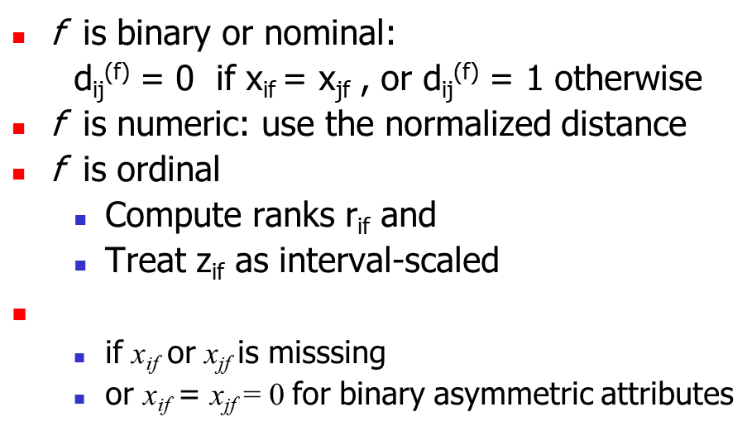
Exercise 11
Find the distance based on all the attributes (mixed type). For numeric attributes, use Manhattan distance.
Ali and Bilal
dist(Ali,Bilal) = (1*1+1*0+1*0+0*1+1*5+1*9+1*0.5)/(1+1+1+0+1+1+1)=15.5/6=2.58
Ali and Faris
dist(Ali,Faris) = (1*1+1*1+1*1+1*1+1*0+1*9+1*1)/(1+1+1+1+1+1+1)=14/7=2
 | Favorite Color | Favorite Food | Plays Chess | Plays Football | Age | Salary (1000s) | Grade
Ali | Blue | Cake | Yes | Yes | 20 | 34 | 1
Bilal | Yellow | Cake | Yes |  | 25 | 25 | 0.5
Ehsan | Yellow | Pasta | Yes | No | 20 | 25 | 1
Faris | Yellow | Burger | No | No | 20 | 25 | 0

Slide 69
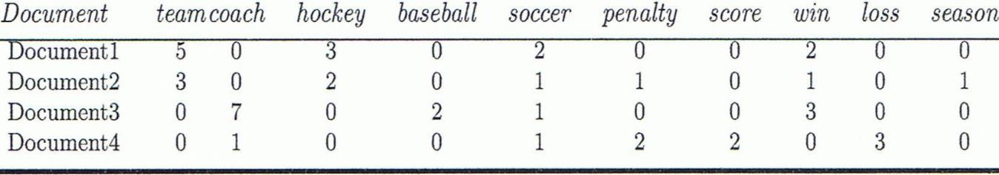
Cosine Similarity
A document can be represented by thousands of attributes, each recording the frequency of a particular word (such as keywords) or phrase in the document.
Other vector objects: gene features in micro-arrays, …
Applications: information retrieval, biologic taxonomy, gene feature mapping, ...
Cosine measure: If d₁ and d₂ are two vectors (e.g., term-frequency vectors), then
where • indicates vector dot product, ||d||: Euclidean norm of vector d.
Notes:
MK: Machine learning used the term “feature VECTORS” > I made some changes to the wording of this slide because it implied that our previous data were not vectors, but they were all feature vectors. I also changed the example since the one used was from Tan’s book (see next slide).
Chapter 3: Statistics Methods
Co-variance distance
K-L divergence

Slide 70
Example: Calculating Cosine Similarity
Calculating Cosine Similarity:
where • indicates vector dot product, ||d||: Euclidean norm of vector d.
Ex: Find the similarity between documents 1 and 2.
d₁ = (5, 0, 3, 0, 2, 0, 0, 2, 0, 0) d₂ = (3, 0, 2, 0, 1, 1, 0, 1, 0, 1)
First, calculate vector dot product
d₁•d₂ = 5 X 3 + 0 X 0 + 3 X 2 + 0 X 0 + 2 X 1 + 0 X 1 + 0 X 1 + 2 X 1 + 0 X 0 + 0 X 1 = 25
Then, calculate ||d₁|| and ||d₂||
Calculate cosine similarity: cos(d₁, d₂ ) = 25/ (6.481 X 4.12) = 0.94

Slide 71
Example
D1: A red apple
D2: I like red apple
D3: Apple computers are good
D4: Red apple red apple red apple red apple
Term by Document Matrix
Cosine(d1,d4) =
(0*0+1*4+1*4+0*0+0*0+0*0+0*0)/(sqrt(2)*sqrt(32))=8/8 = 1
 | This | Red | Apple | I | Like | Comp | Good
D1 | 0 | 1 | 1 | 0 | 0 | 0 | 0
D2 | 0 | 1 | 1 | 1 | 1 | 0 | 0
D3 | 0 | 0 | 1 | 0 | 0 | 1 | 1
D4 | 0 | 4 | 4 | 0 | 0 | 0 | 0

Slide 72
Exercise 12
Create a term by document matrix for the following documents (only consider green terms)
D1: I like to eat red apples
D2: Red apples are sweet
D3: Apple computers are easy to use computers
Find the distance cosine similarity between
D1 and D2
D1 and D3

Slide 73
Exercise 12
Create a term by document matrix for the following documents
D1: I like to eat red apples
D2: Red apples are sweet
D3: Apple computers are easy to use computers
Find the distance cosine similarity between
D1 and D2
D1 and D3
 | Like
D1
D2
D3

Slide 74
Exercise 12
Create a term by document matrix for the following documents
D1: I like to eat red apples
D2: Red apples are sweet
D3: Apple computers are easy to use computers
Find the distance cosine similarity between
||d1|| = sqrt(1^2 + 1^2+ 1^2 + 1^2) = sqrt(4)
||d2|| = sqrt(1^2 + 1^2 + 1^2) = sqrt(3)
||d3|| = sqrt(1^2 + 2^2+ 1^2 + 1^2) = sqrt(7)
D1 and D2
sim(d1,d2) = (1+1)/(sqrt(4)*sqrt(3)) = 2/sqrt(12)
D1 and D3
sim(d1,d3) = 1/(sqrt(4)*sqrt(7)) = 1/sqrt(28)
 | like | eat | red | apples | sweet | computers | easy | use
D1 | 1 | 1 | 1 | 1 | 0 | 0 | 0 | 0
D2 | 0 | 0 | 1 | 1 | 1 | 0 | 0 | 0
D3 | 0 | 0 | 0 | 1 | 0 | 2 | 1 | 1

Slide 75
Chapter 2: Getting to Know Your Data
Data Objects and Attribute Types
Basic Statistical Descriptions of Data
Data Visualization
Measuring Data Similarity and Dissimilarity
Summary

Slide 76
Summary
Data attribute types: nominal, binary, ordinal, interval-scaled, ratio-scaled
Many types of data sets, e.g., numerical, text, graph, Web, image.
Gain insight into the data by:
Basic statistical data description: central tendency, dispersion, graphical displays
Data visualization: map data onto graphical primitives
Measure data similarity
Above steps are the beginning of data preprocessing.
Many methods have been developed but still an active area of research.
Notes:
08/10/23: This slide was out of date. Draft of new version above.
Cut out the following:
Data description, data exploration, and measure data similarity set the basis for quality data preprocessing
A lot of methods have been developed but data preprocessing still an active area of research

Slide 77
References
W. Cleveland, Visualizing Data, Hobart Press, 1993
T. Dasu and T. Johnson. Exploratory Data Mining and Data Cleaning. John Wiley, 2003
U. Fayyad, G. Grinstein, and A. Wierse. Information Visualization in Data Mining and Knowledge Discovery, Morgan Kaufmann, 2001
L. Kaufman and P. J. Rousseeuw. Finding Groups in Data: an Introduction to Cluster Analysis. John Wiley & Sons, 1990.
H. V. Jagadish et al., Special Issue on Data Reduction Techniques. Bulletin of the Tech. Committee on Data Eng., 20(4), Dec. 1997
D. A. Keim. Information visualization and visual data mining, IEEE trans. on Visualization and Computer Graphics, 8(1), 2002
D. Pyle. Data Preparation for Data Mining. Morgan Kaufmann, 1999
S. Santini and R. Jain,” Similarity measures”, IEEE Trans. on Pattern Analysis and Machine Intelligence, 21(9), 1999
E. R. Tufte. The Visual Display of Quantitative Information, 2nd ed., Graphics Press, 2001
C. Yu et al., Visual data mining of multimedia data for social and behavioral studies, Information Visualization, 8(1), 2009
Notes:
MK 08.11.02: This needs to be updated to reflect changes.

